Slide 1

Unit-III Cognitive Models

Slide 2
Cognitive Models in HCI
In HCI, three different approaches are used to model cognition
Individual models of human factors
In this approach, individual human factors such as manual (motor) movement, eye movement, decision time in the presence of visual stimuli etc. are modeled
Examples are the Hick-Hyman law, the Fitts’ law
Integrated cognitive architectures
Here, the whole human cognition process (including perception and motor actions) is modeled
Examples are MHP, ACT-R/PM, Soar

Slide 3
Cognitive Models in HCI
Simple models of human information processing
Most well-known and widely used models based on this approach is the GOMS family of models

Slide 4
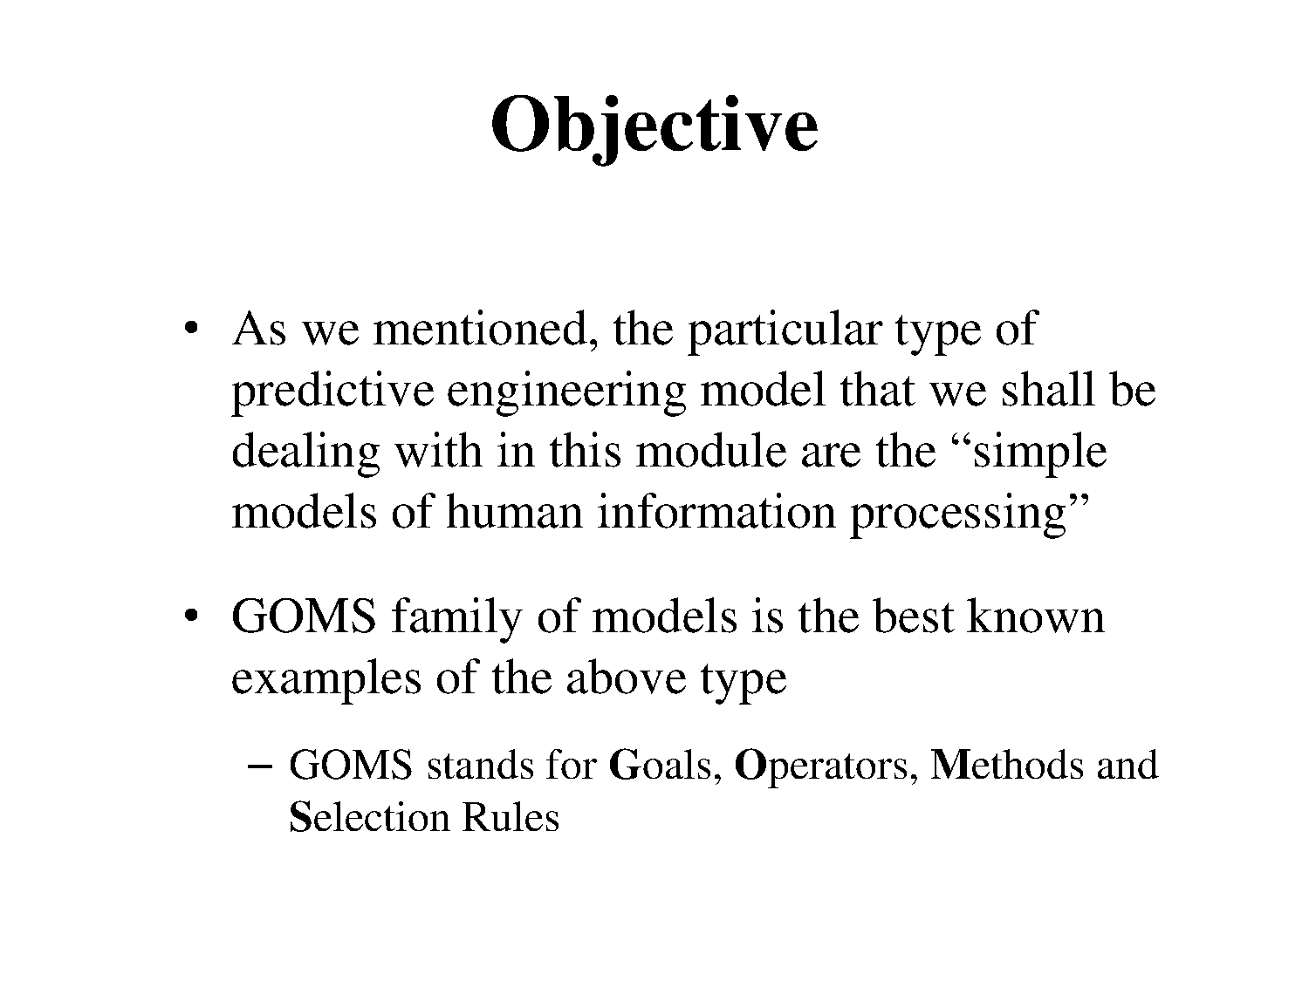

Slide 5
GOMS
Goals
What the user wants to achieve
Operators
Basic actions user performs
System state Eg: key press
Mental state Eg: read dialog box
Methods
Decomposition of a goal into sub-goals/operators
Selection
Means of choosing between competing methods

Slide 6
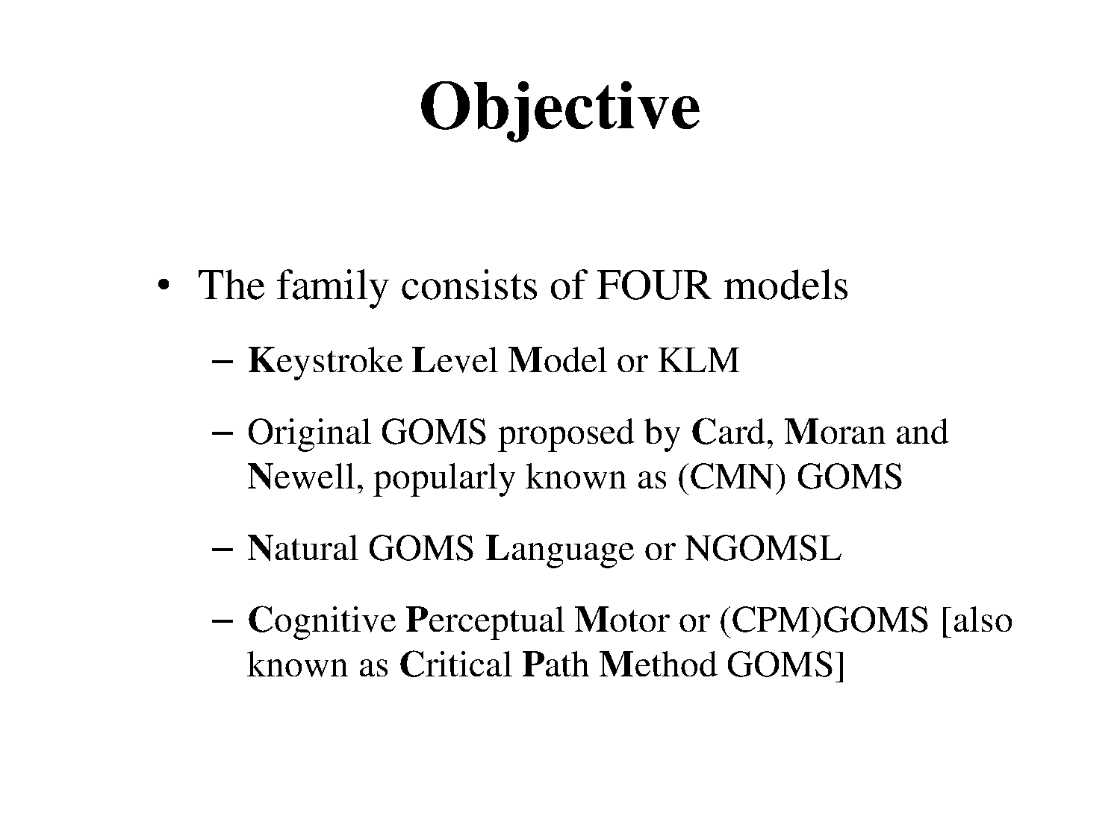

Slide 7
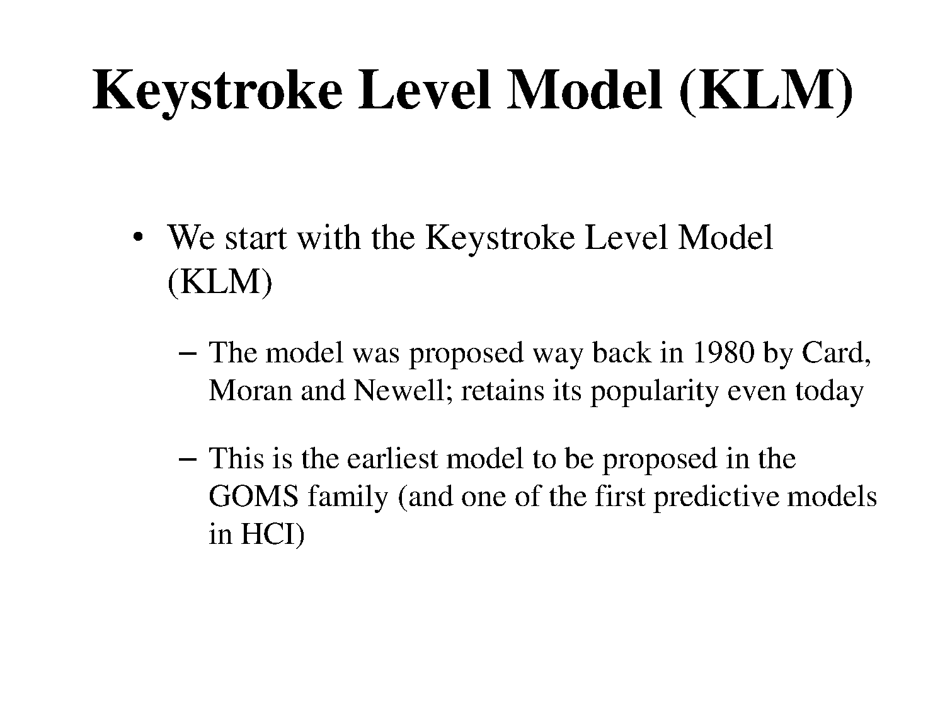

Slide 8
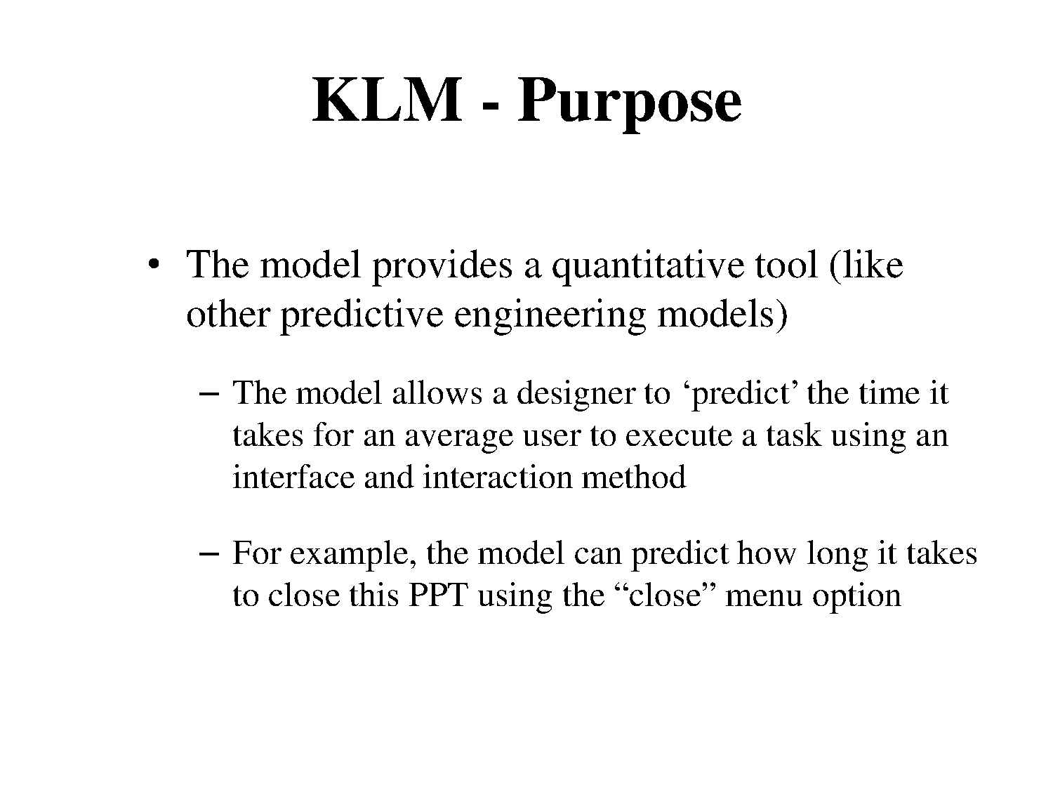

Slide 9
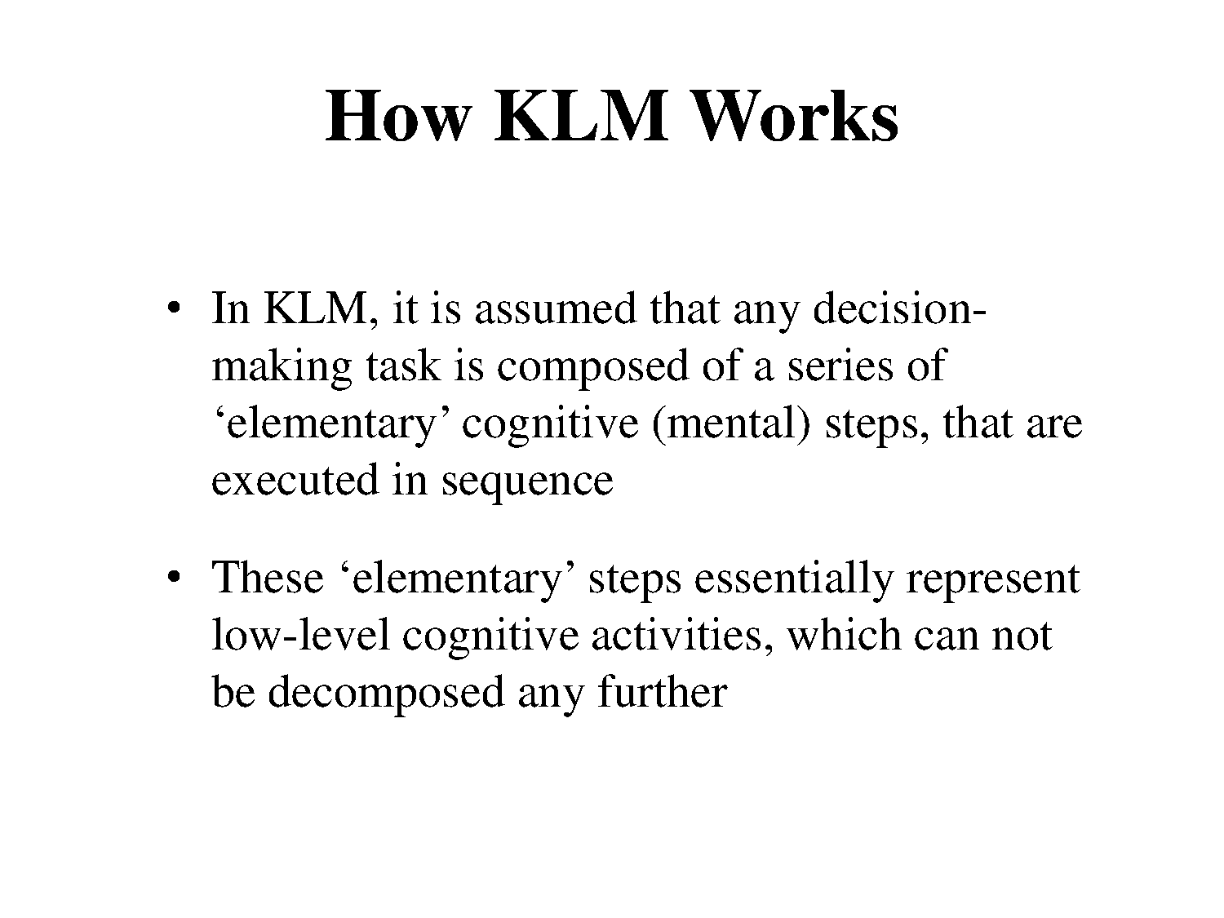

Slide 10
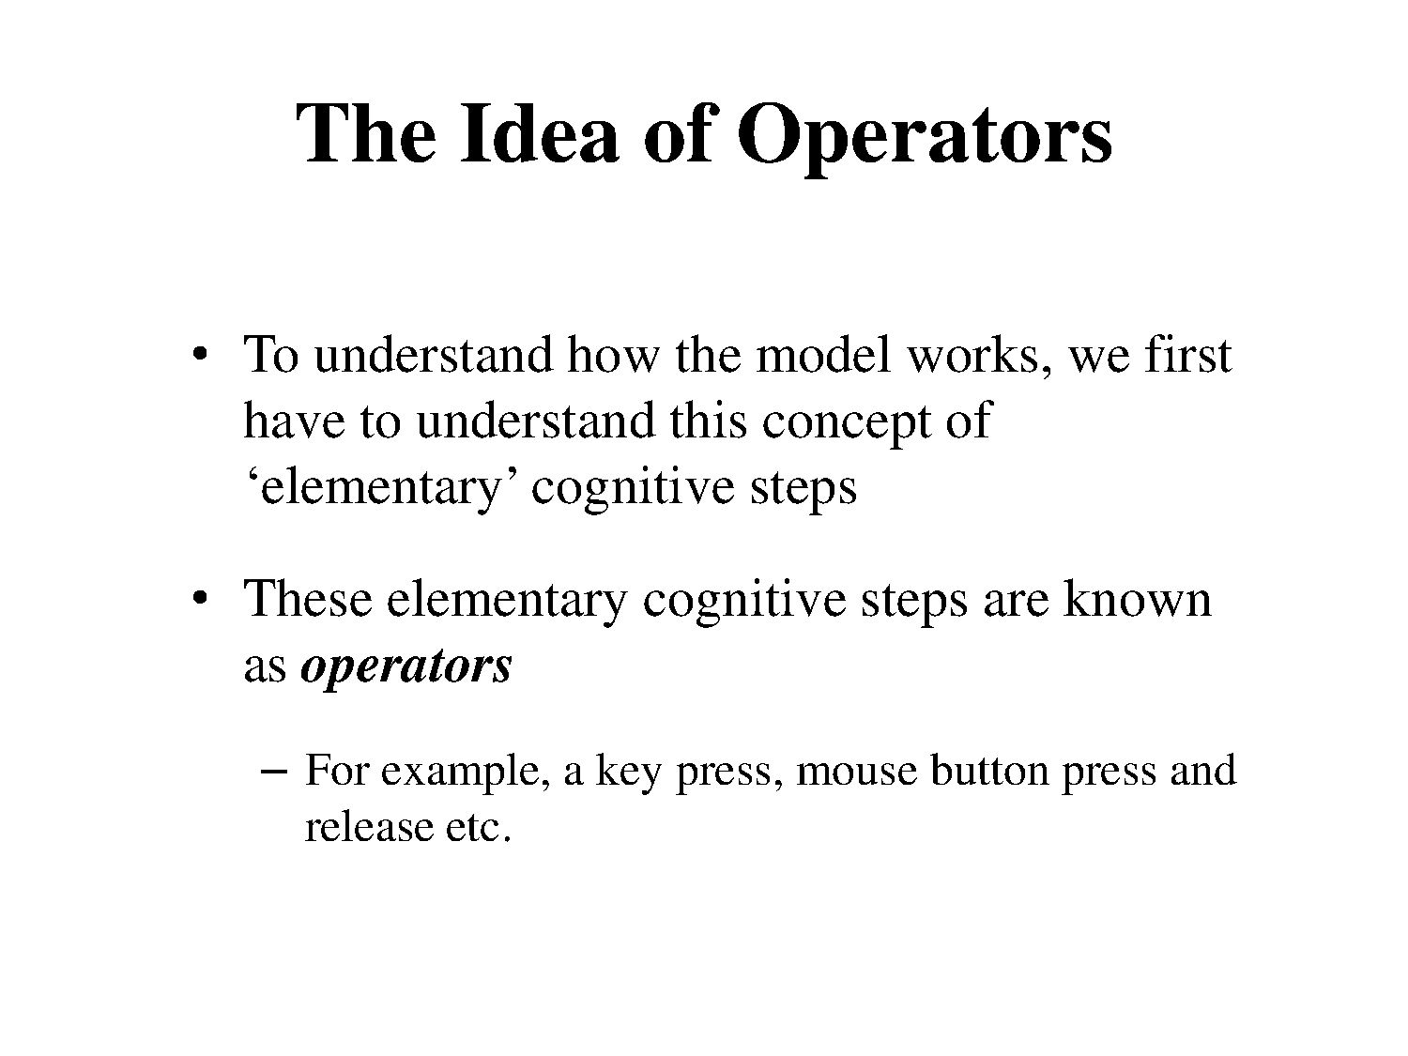

Slide 11
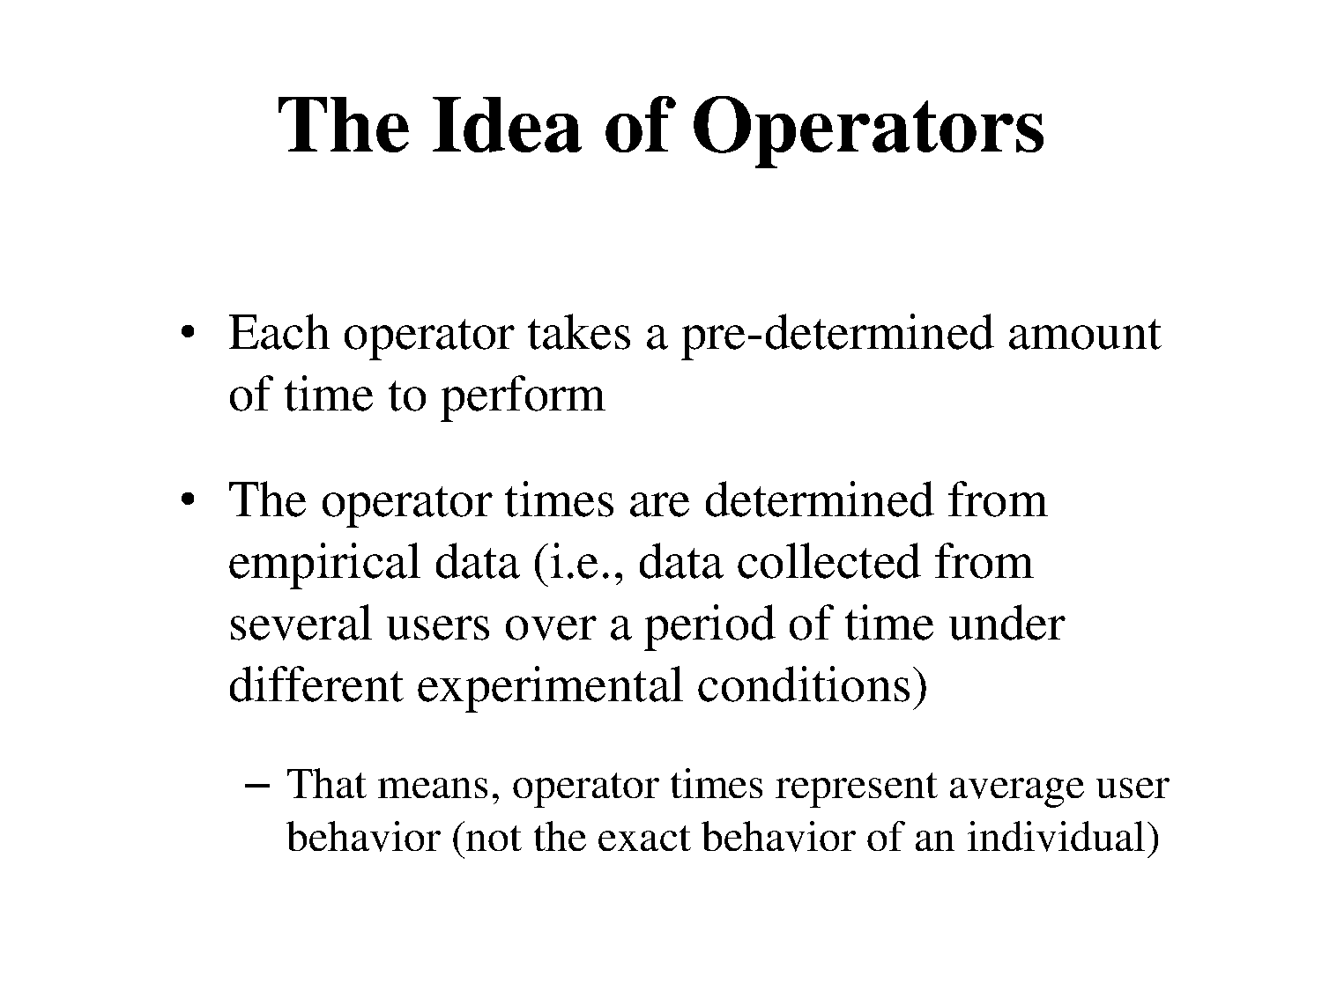

Slide 12
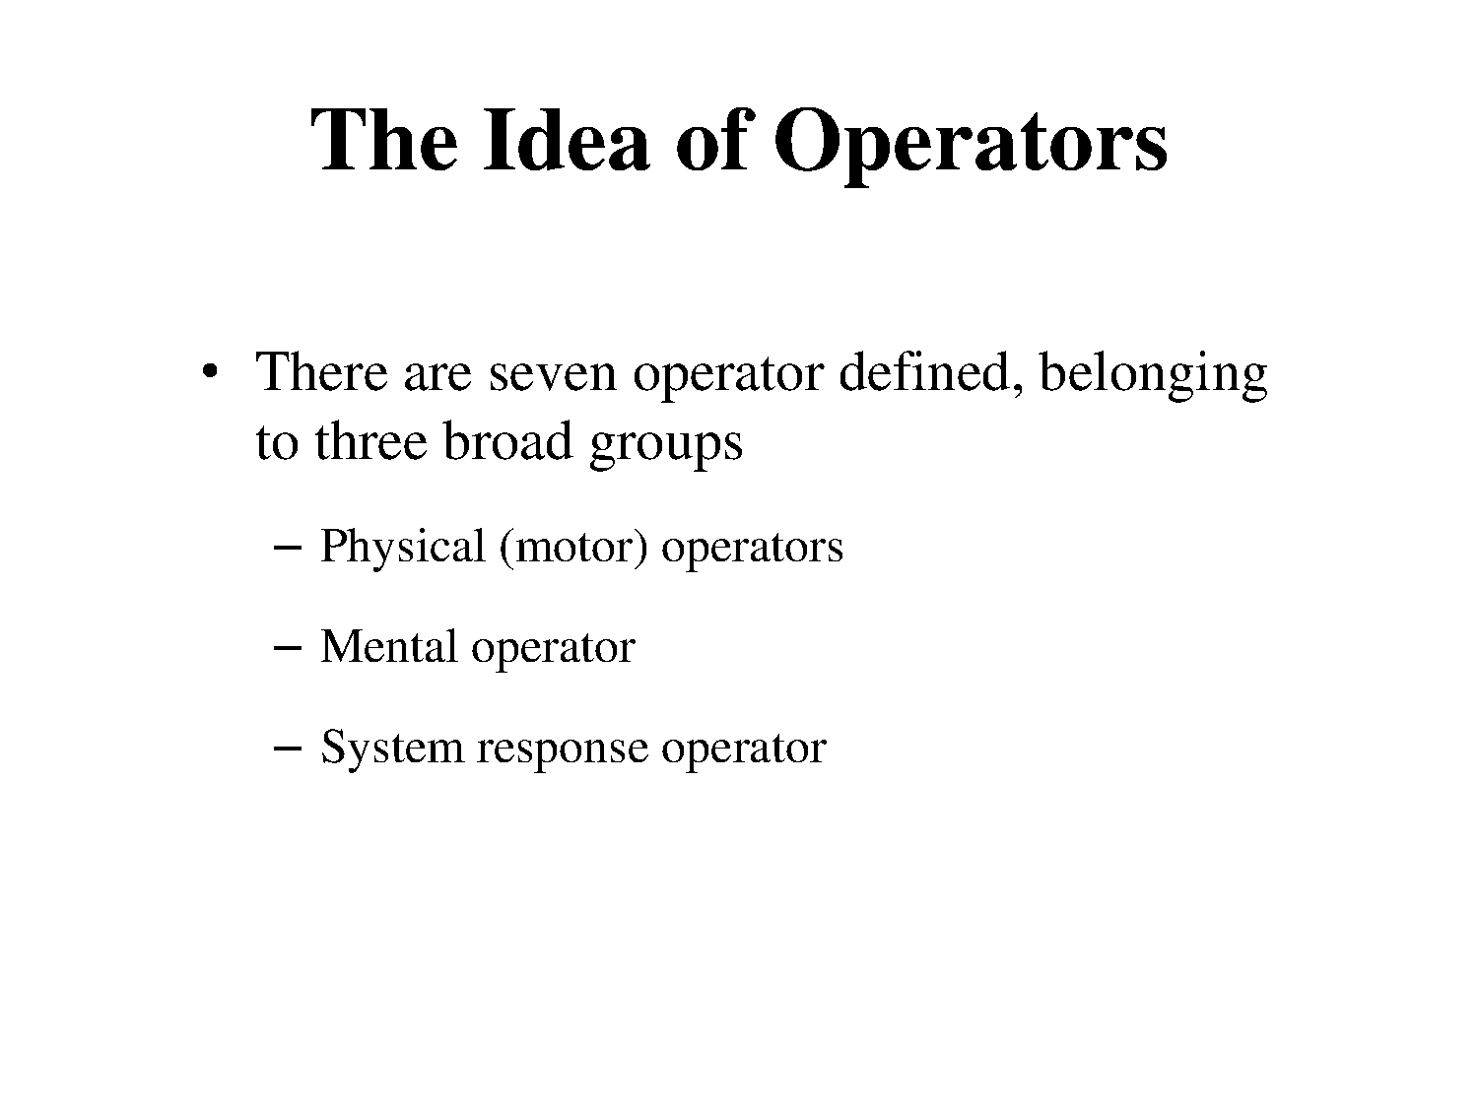

Slide 13
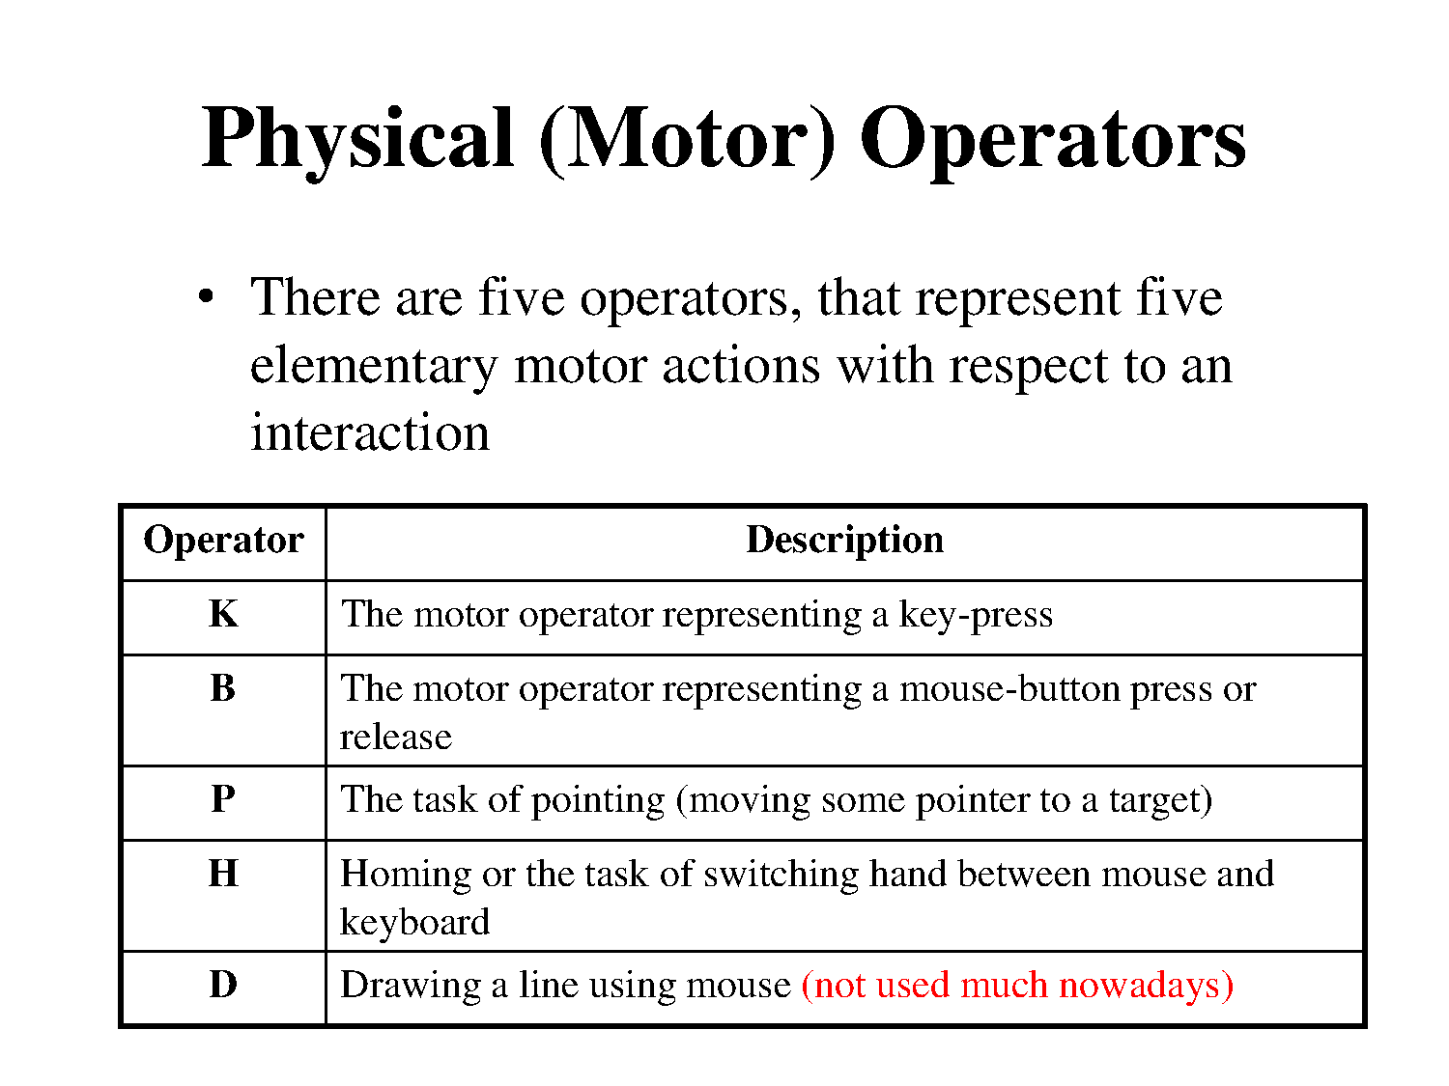

Slide 14
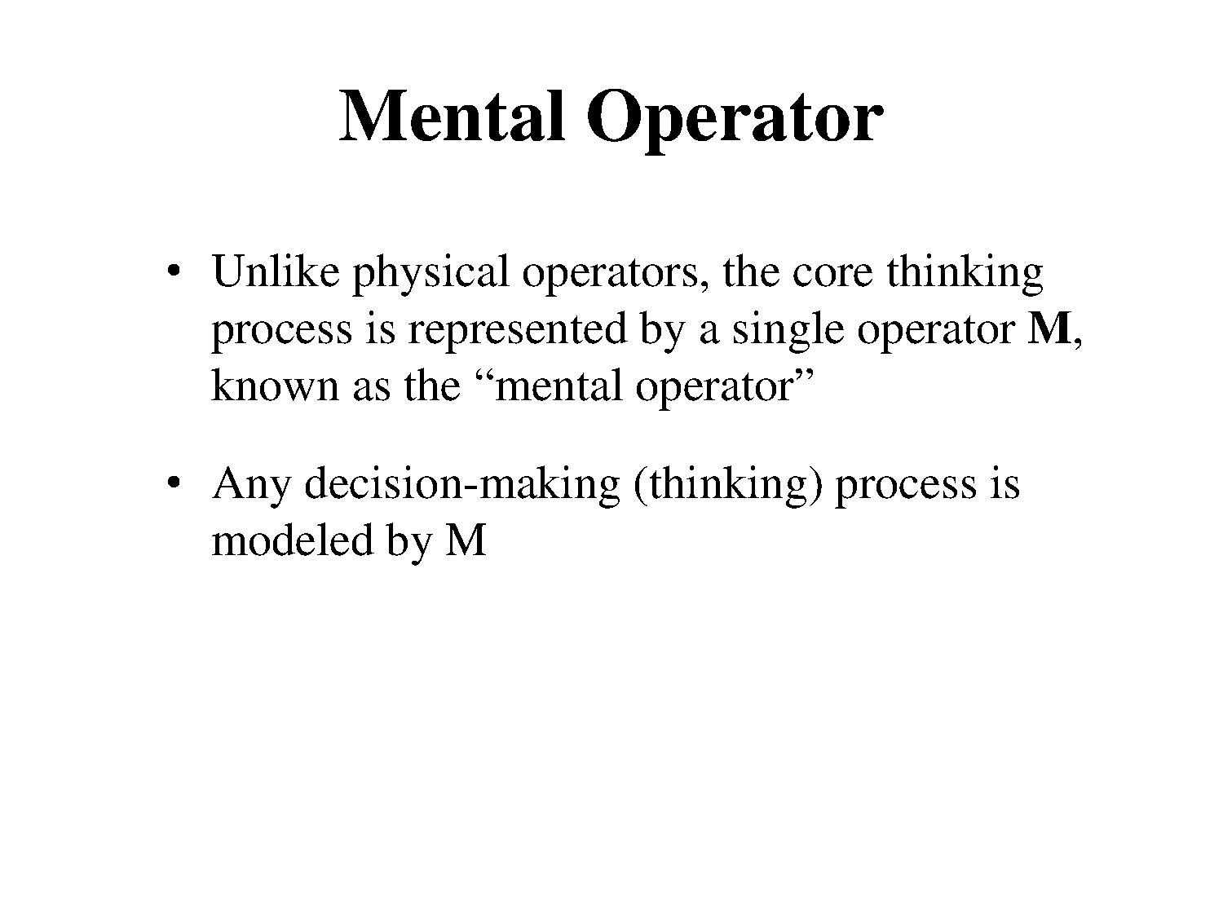

Slide 15
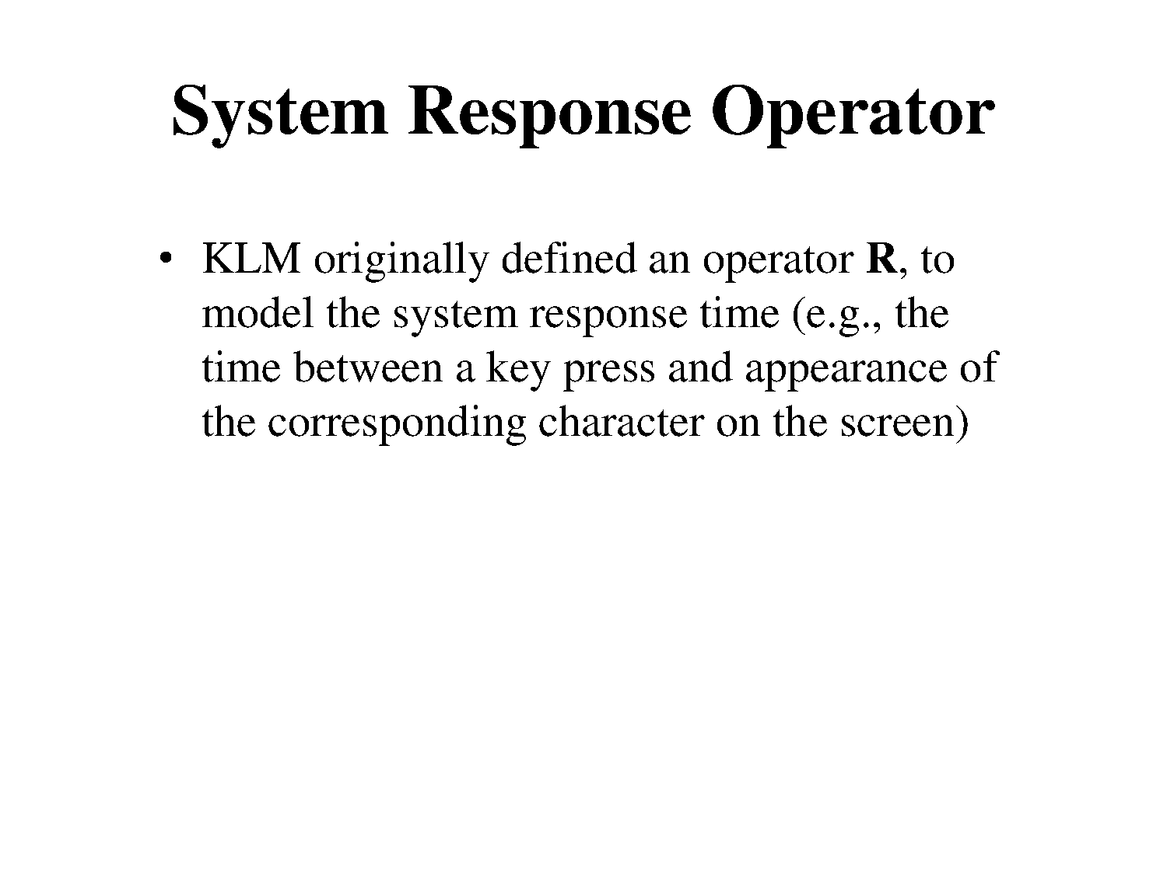

Slide 16
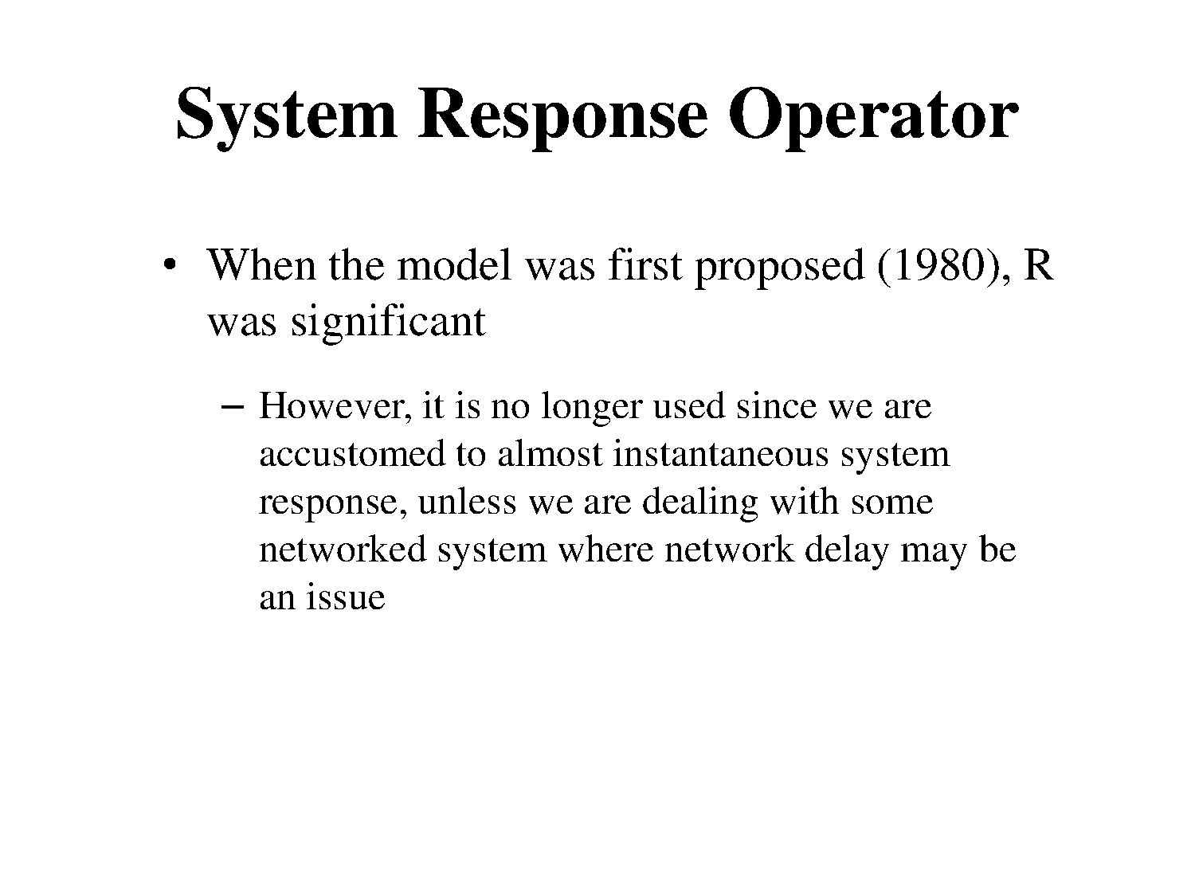

Slide 17
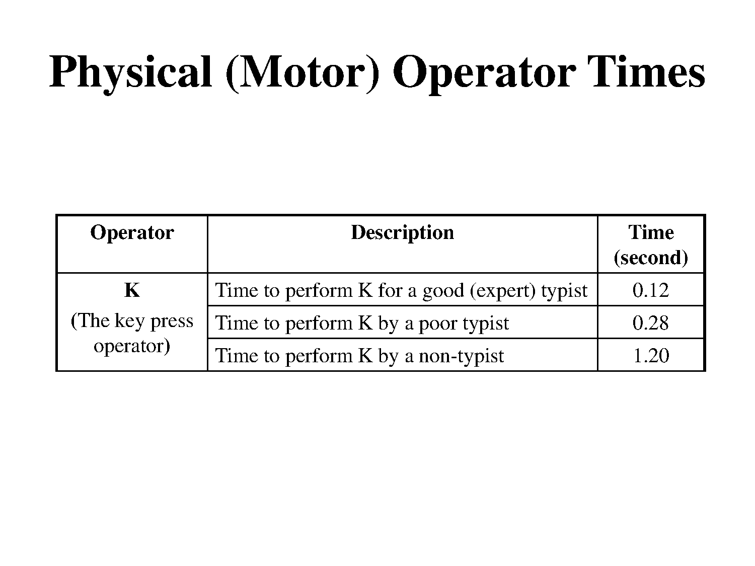

Slide 18
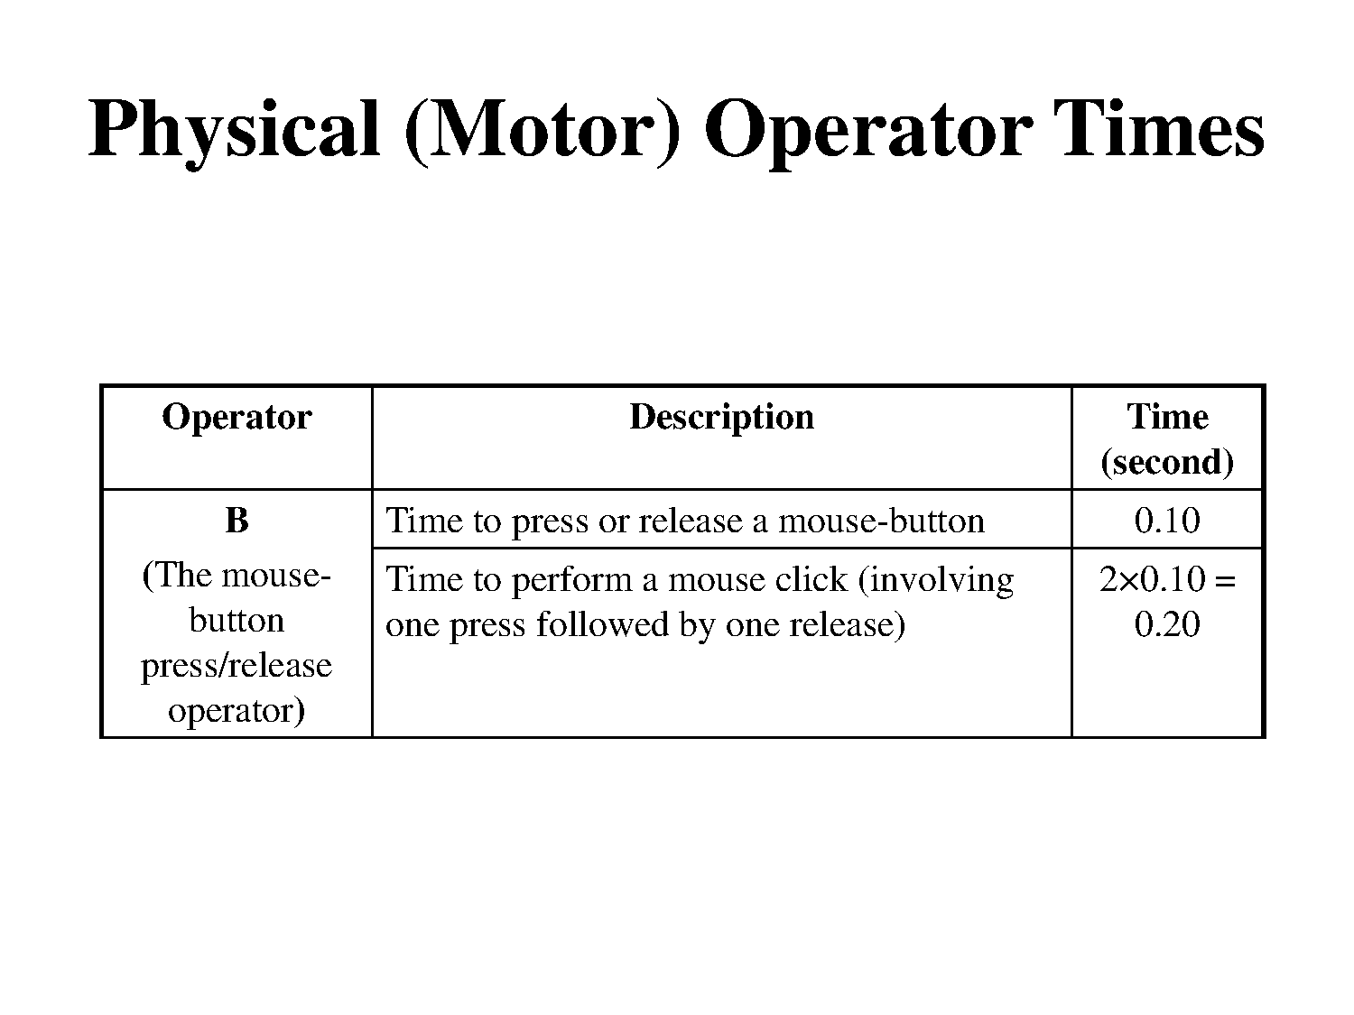

Slide 19
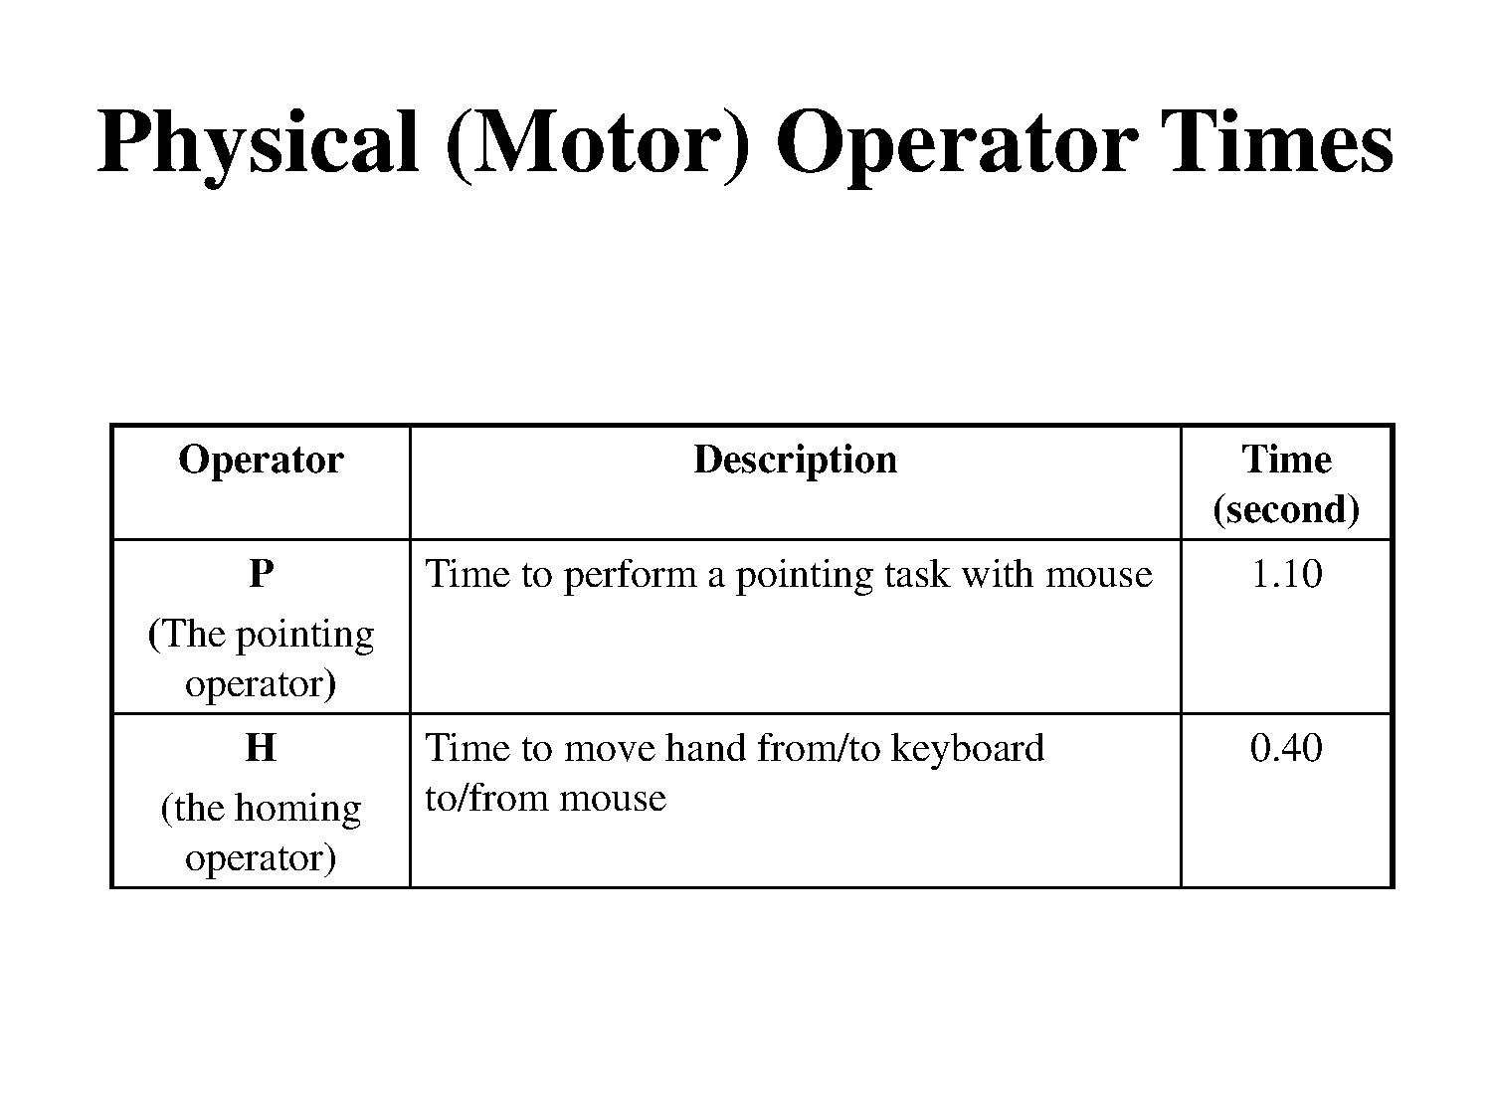

Slide 20
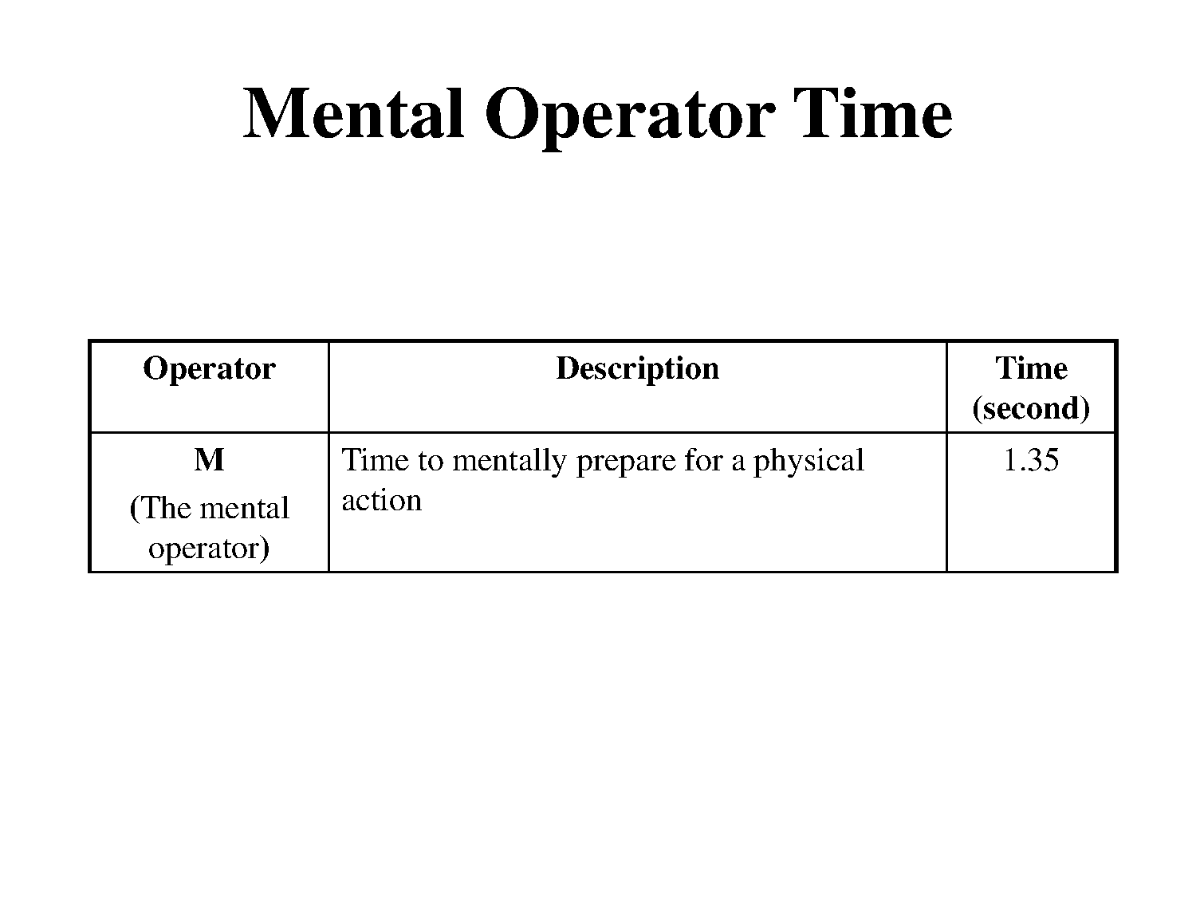

Slide 21
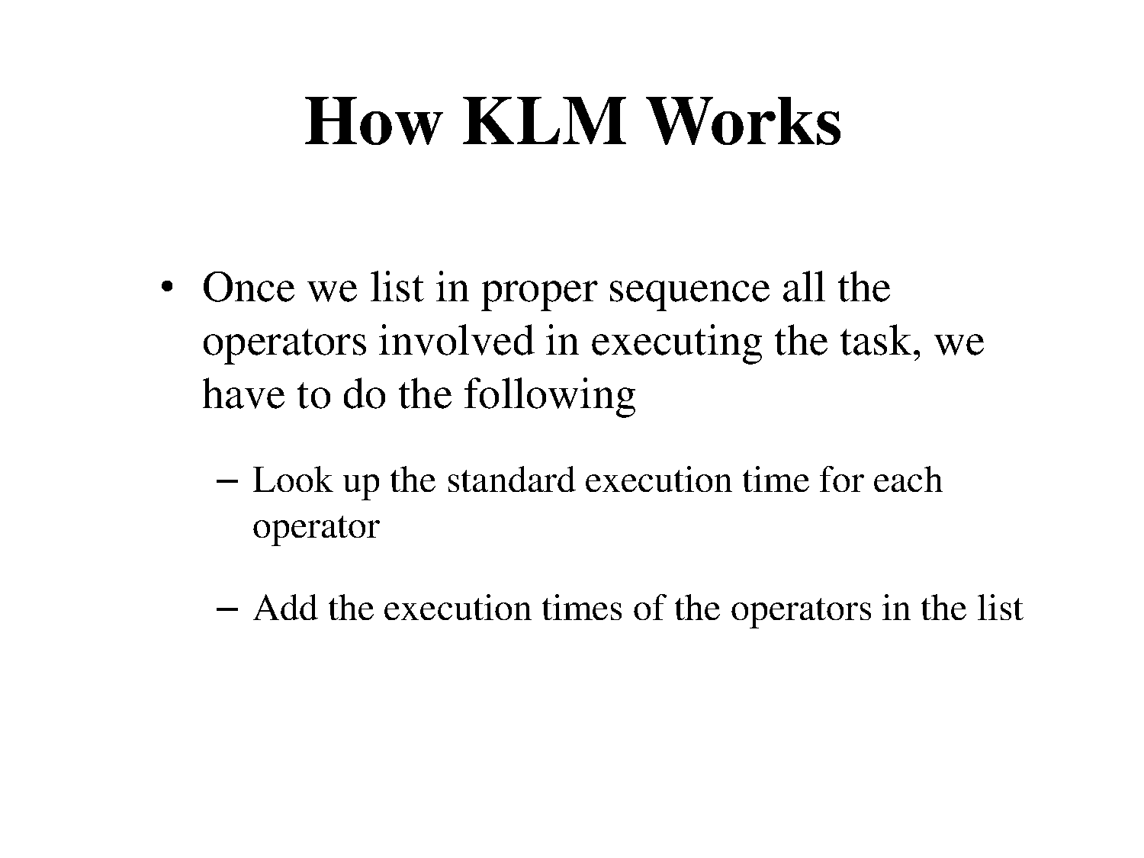

Slide 22
How KLM Works
There are 7 execution operators
Physical motor:
K - keystroking
P - pointing
H - homing
D – drawing
B – mouse button press
Mental M - mental preparation
System R - response
Times are empirically determined.
T_{execute} = TK + TP + TH + TB + TM + TR

Slide 23
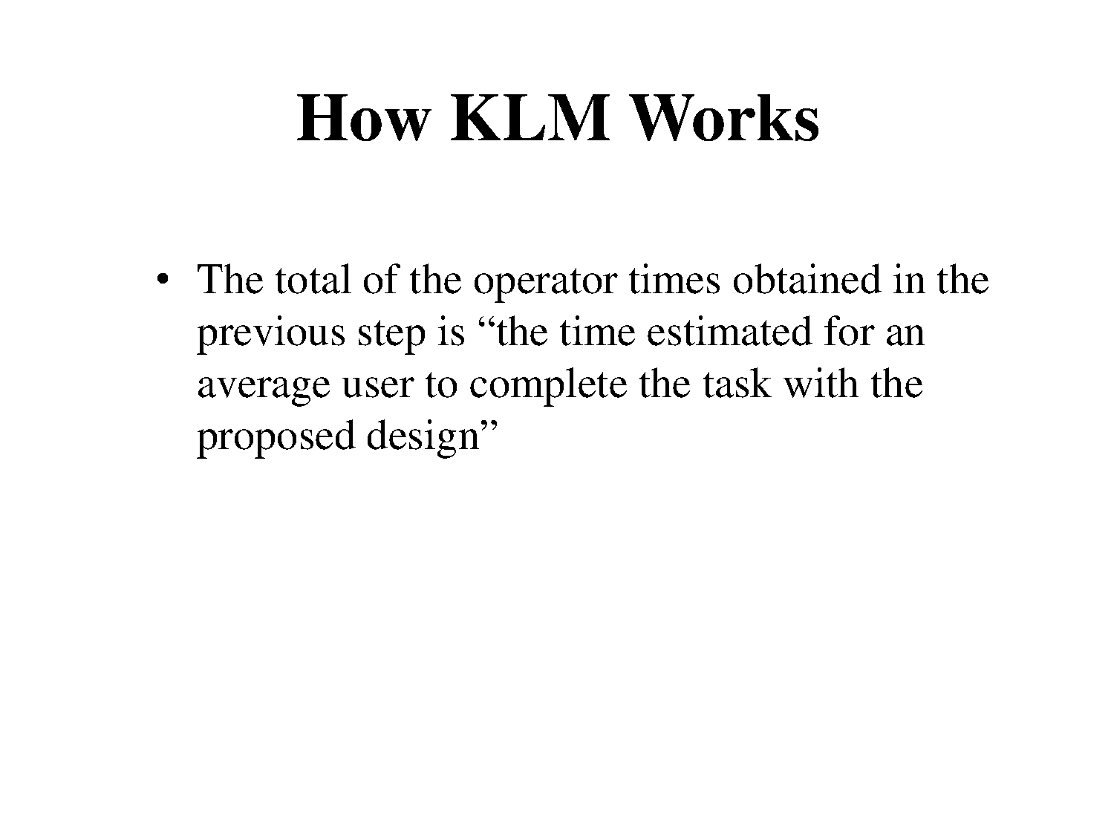

Slide 24
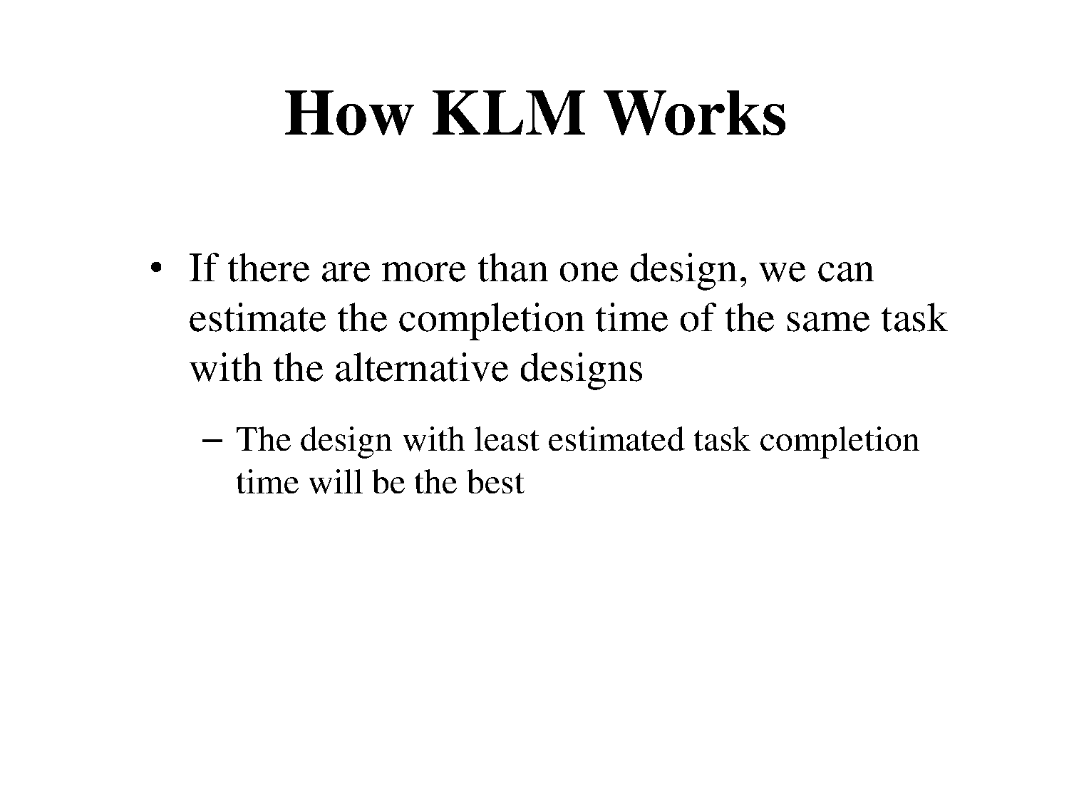

Slide 25
GOMS example
GOAL: CLOSE-WINDOW
[select GOAL: USE-MENU-METHOD
MOVE-MOUSE-TO-FILE-MENU
PULL-DOWN-FILE-MENU
CLICK-OVER-CLOSE-OPTION
GOAL: USE-CTRL-W-METHOD
PRESS-CONTROL-W-KEYS]
For a particular user:
Rule 1: Select USE-MENU-METHOD unless another rule applies
Rule 2: If the application is GAME, select CTRL-METHOD

Slide 26
Model based design keystroke level model

Slide 27
GOMS Variants
KLM - Simplest version (Card, Moran, Newell 1983)
CMN-GOMS - Original formulation; includes methods and selection rules (Card, Moran, Newell 1983)
NGOMSL - GOMS using natural language; also can model memory usage and learning times (Kieras 1988)
CPM-GOMS - Models parallel processing by cognitive, perceptual and motor systems (John 1990)
Source: John and Kieras, “The GOMS Family of User Interface Analysis Techniques”

Slide 28
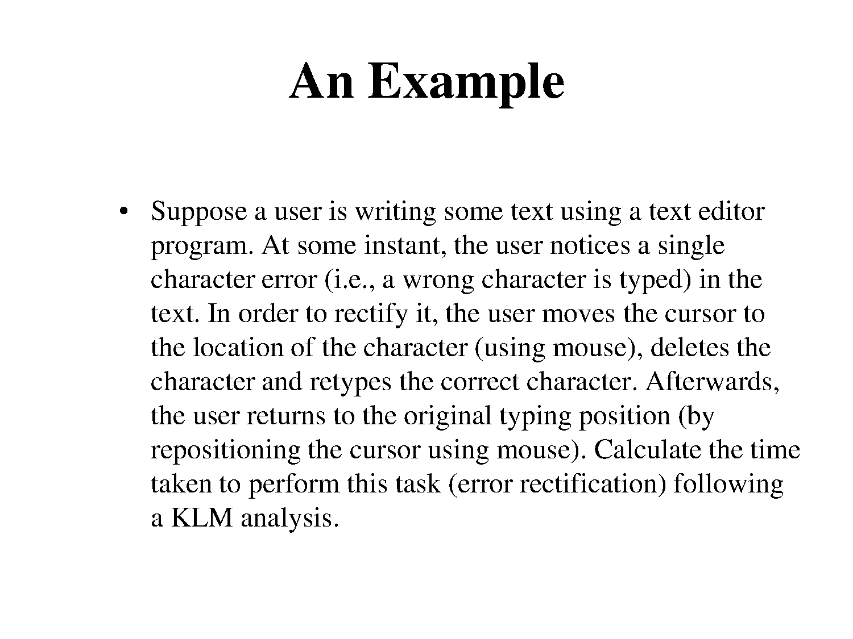

Slide 29
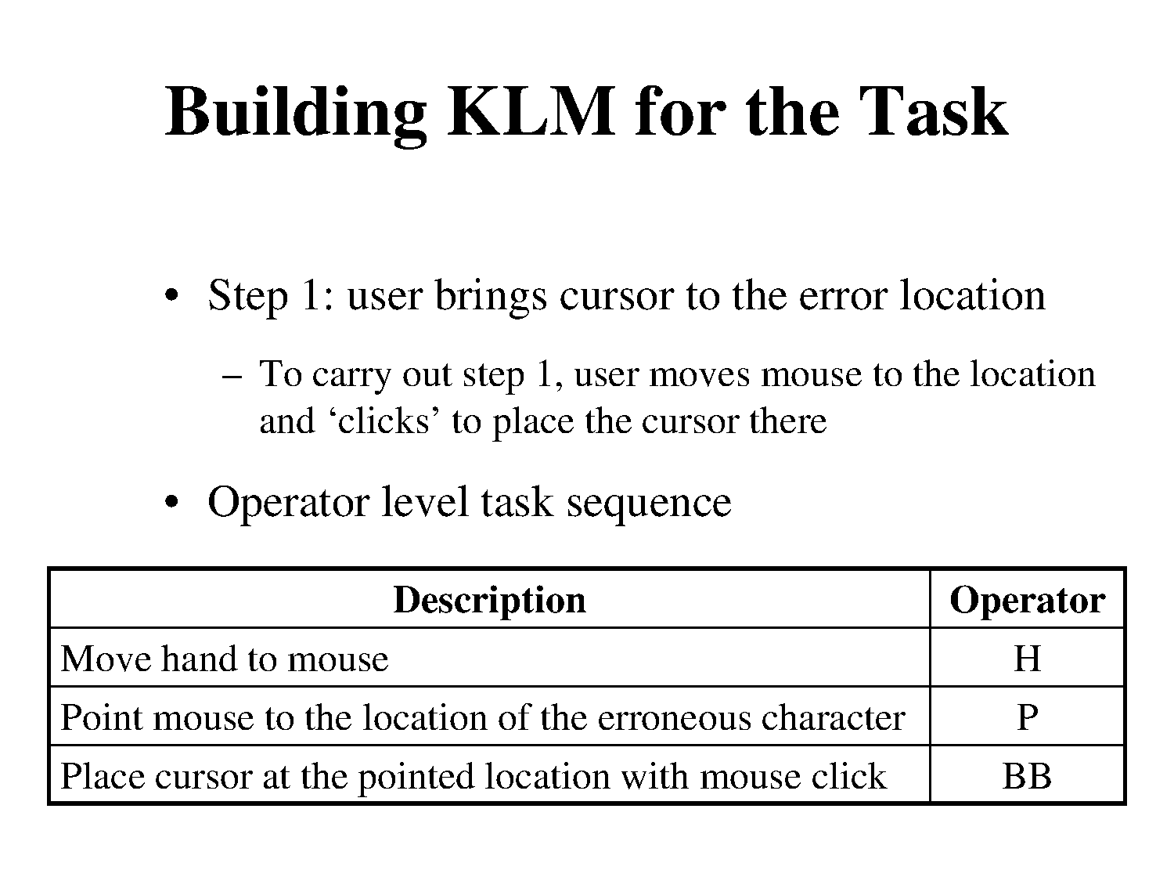

Slide 30
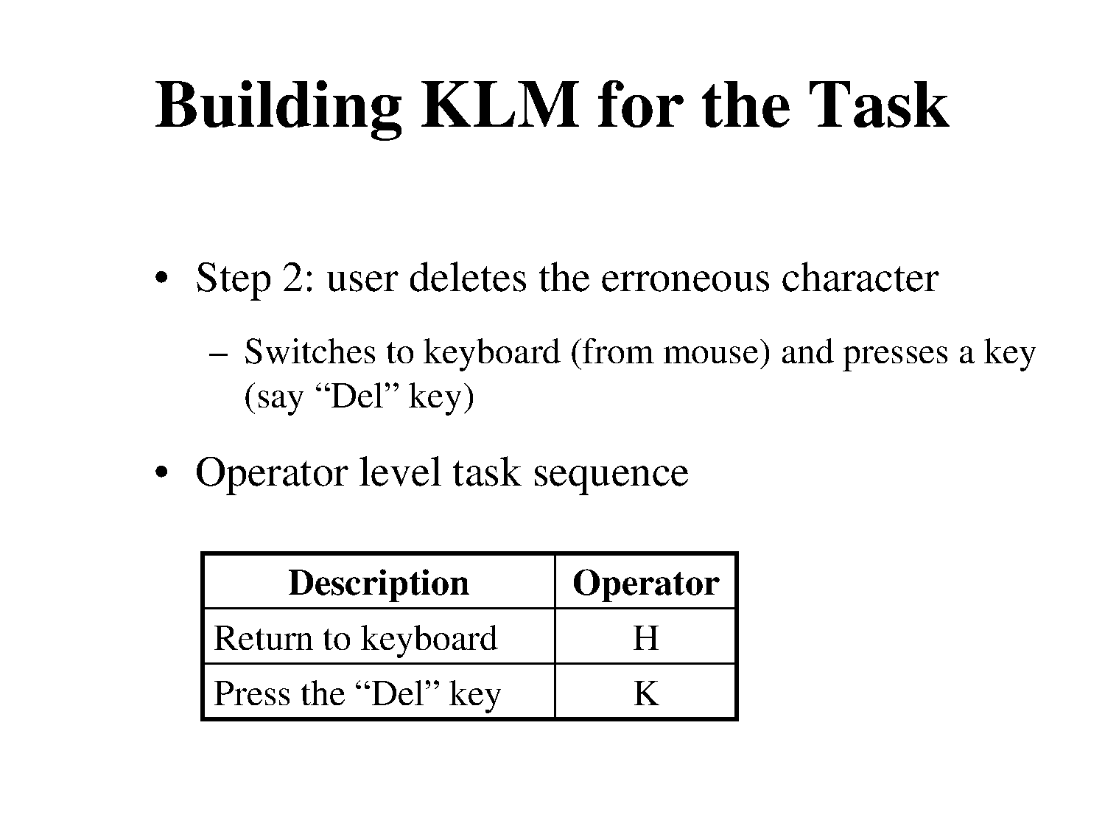

Slide 31
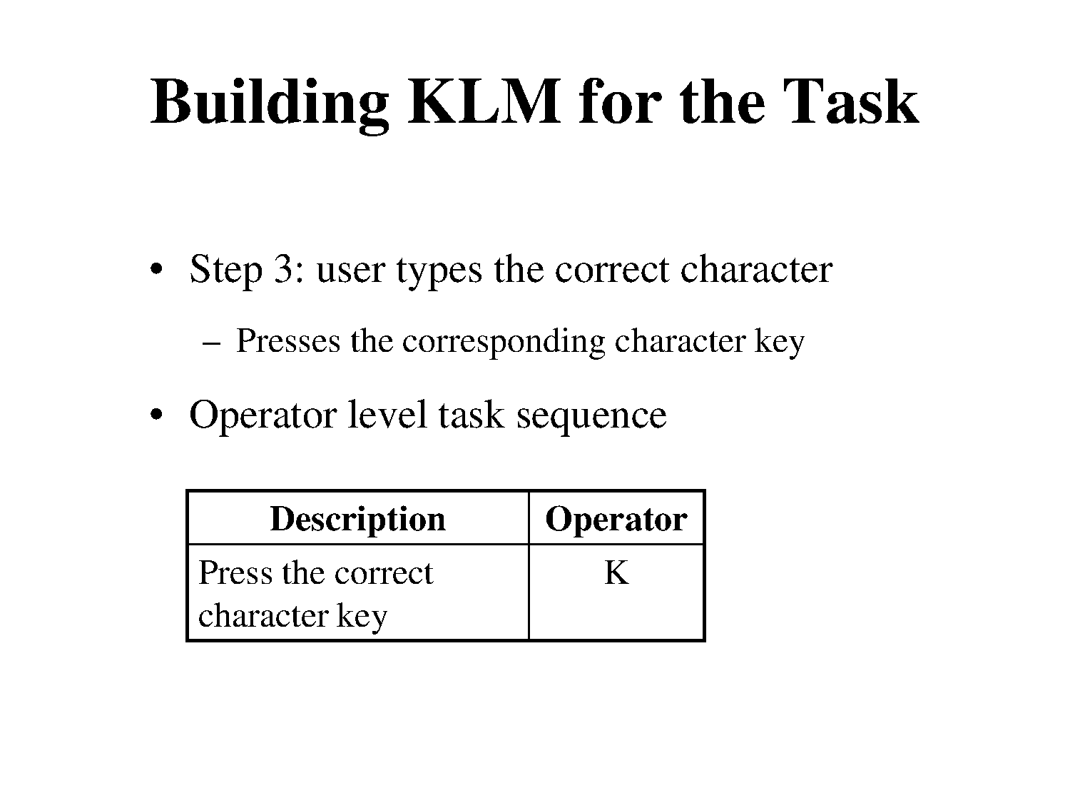

Slide 32
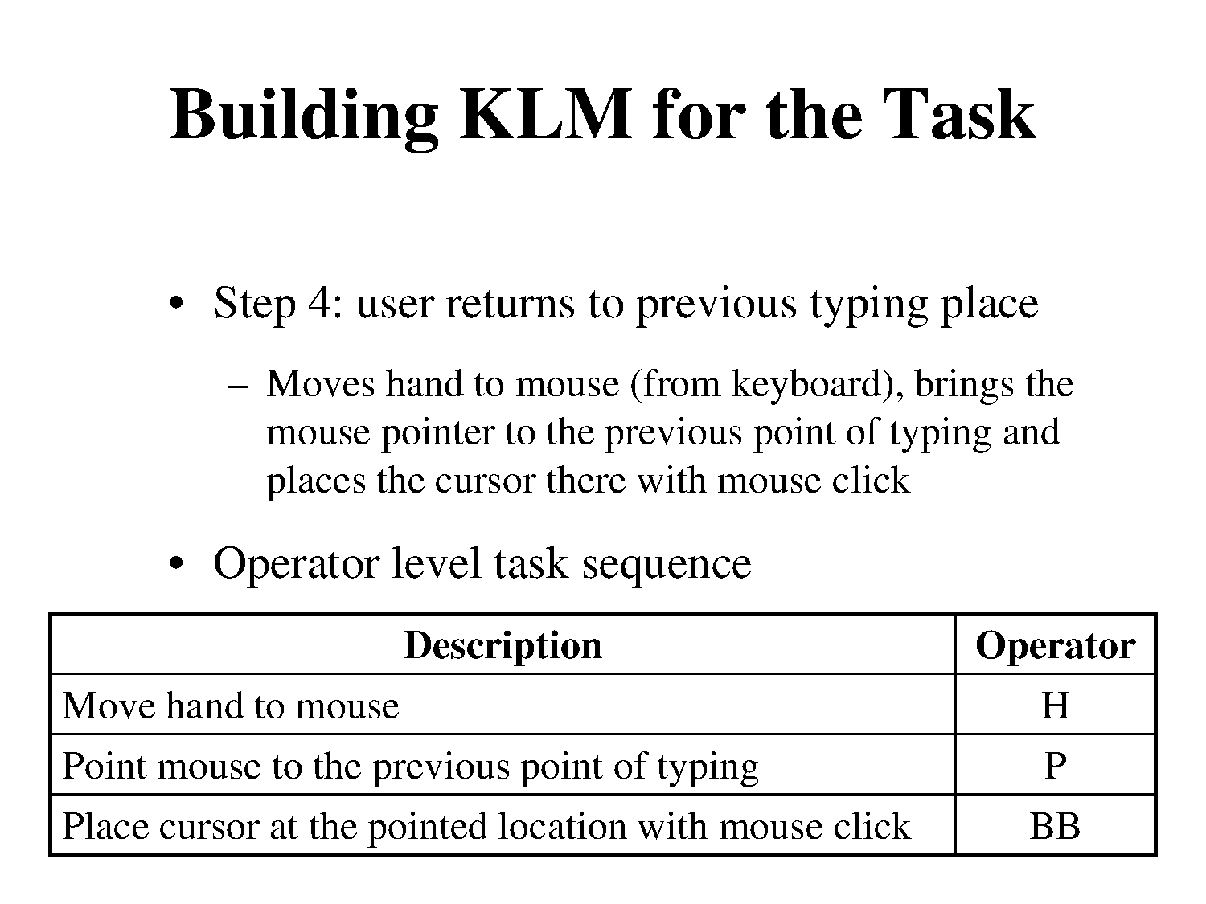

Slide 33
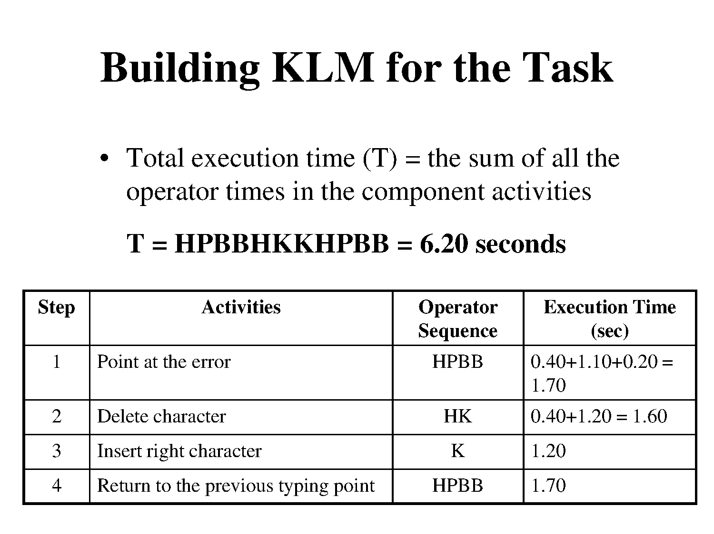

Slide 34
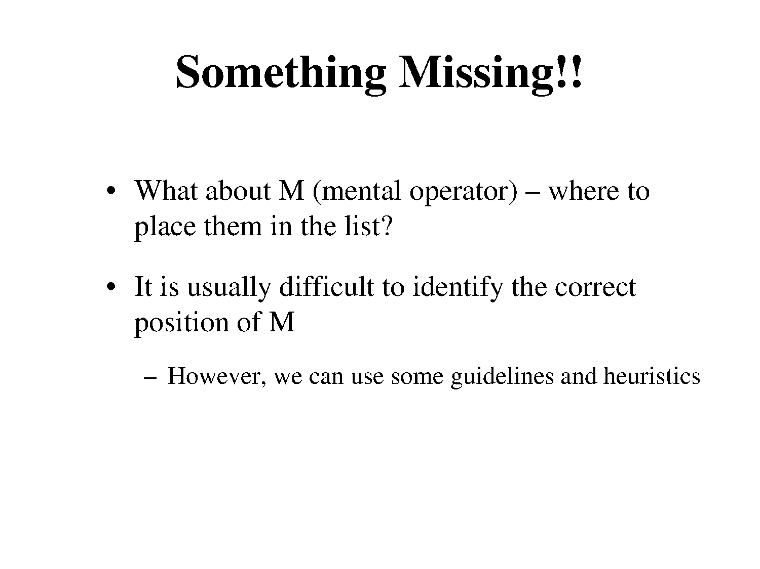

Slide 35
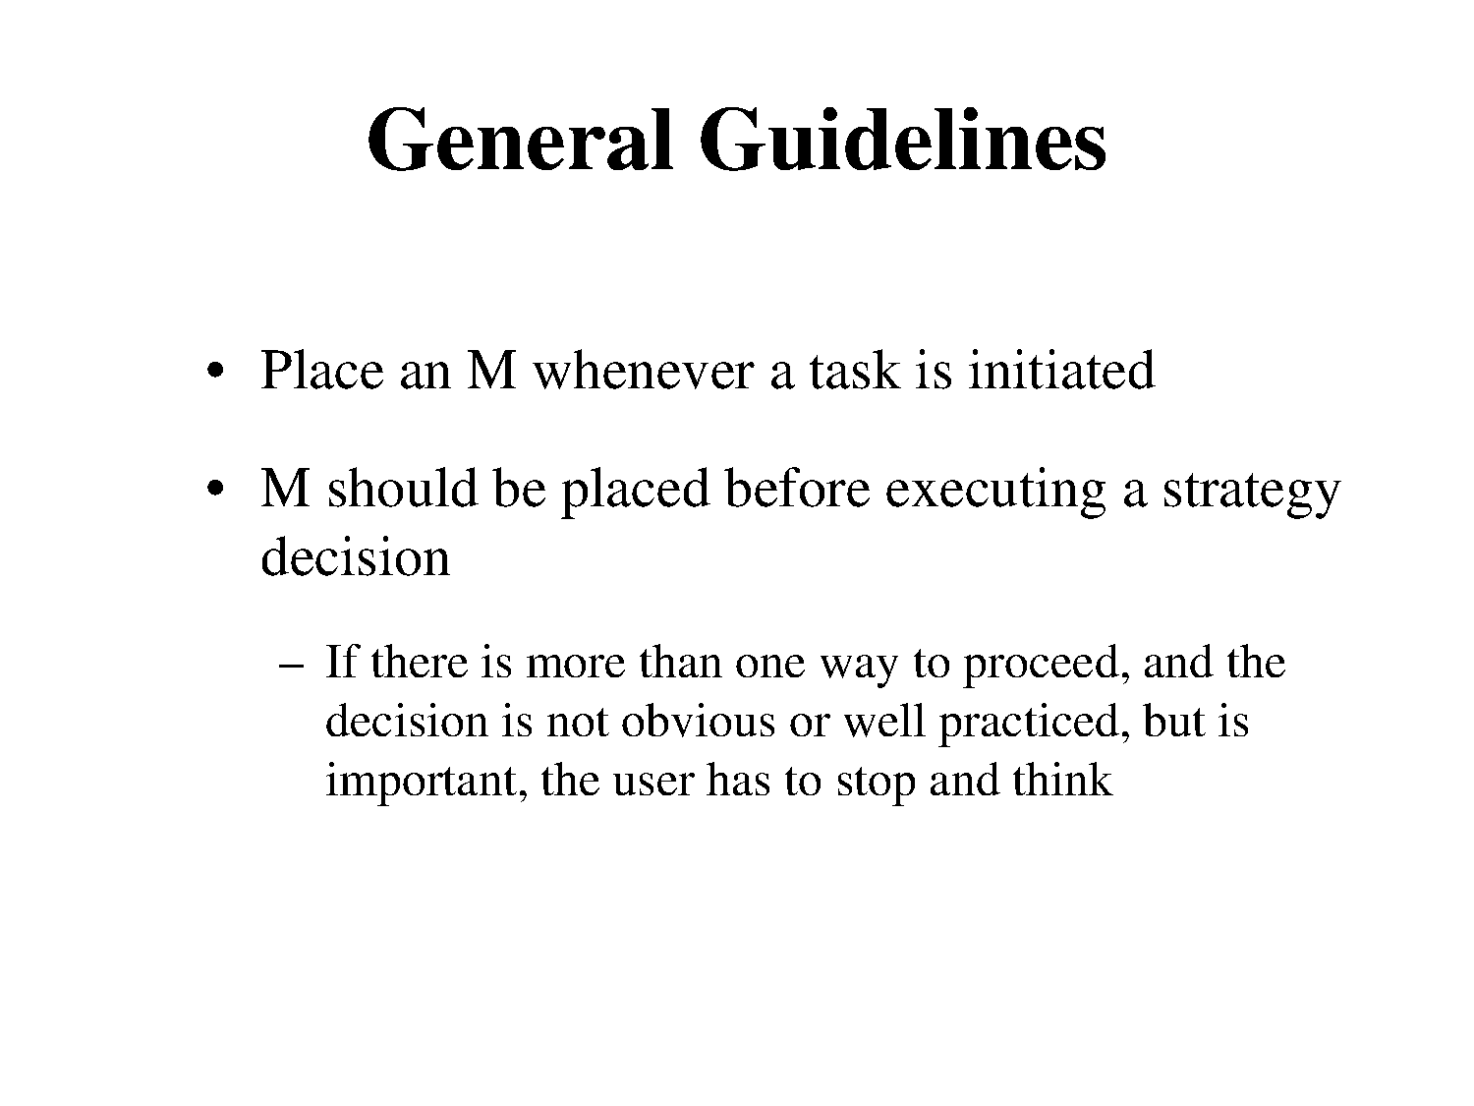

Slide 36
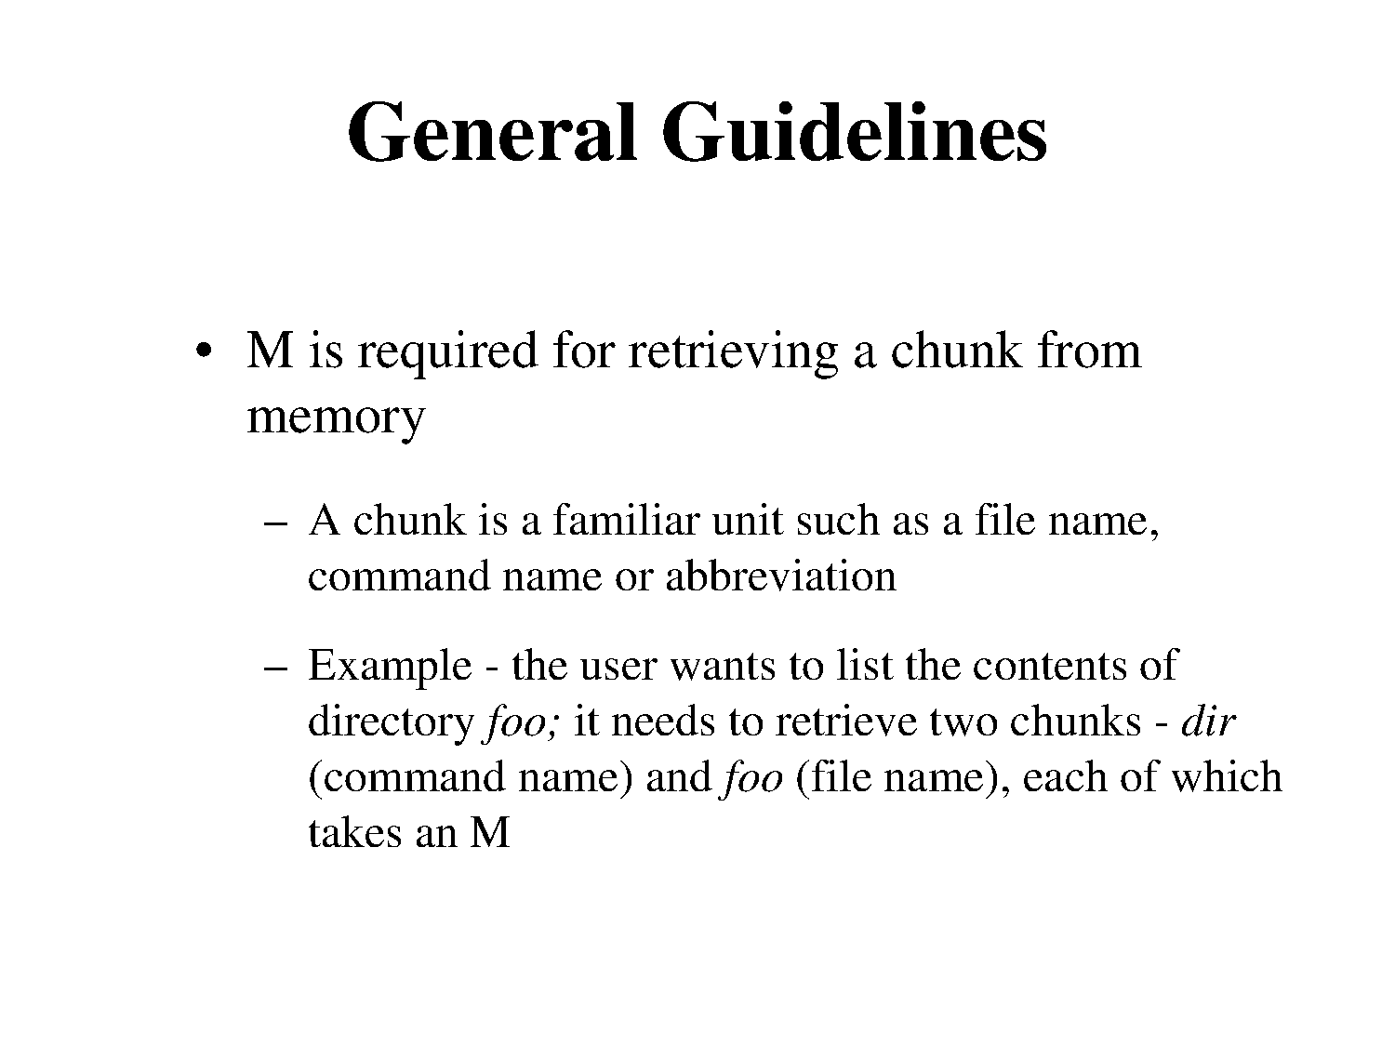

Slide 37
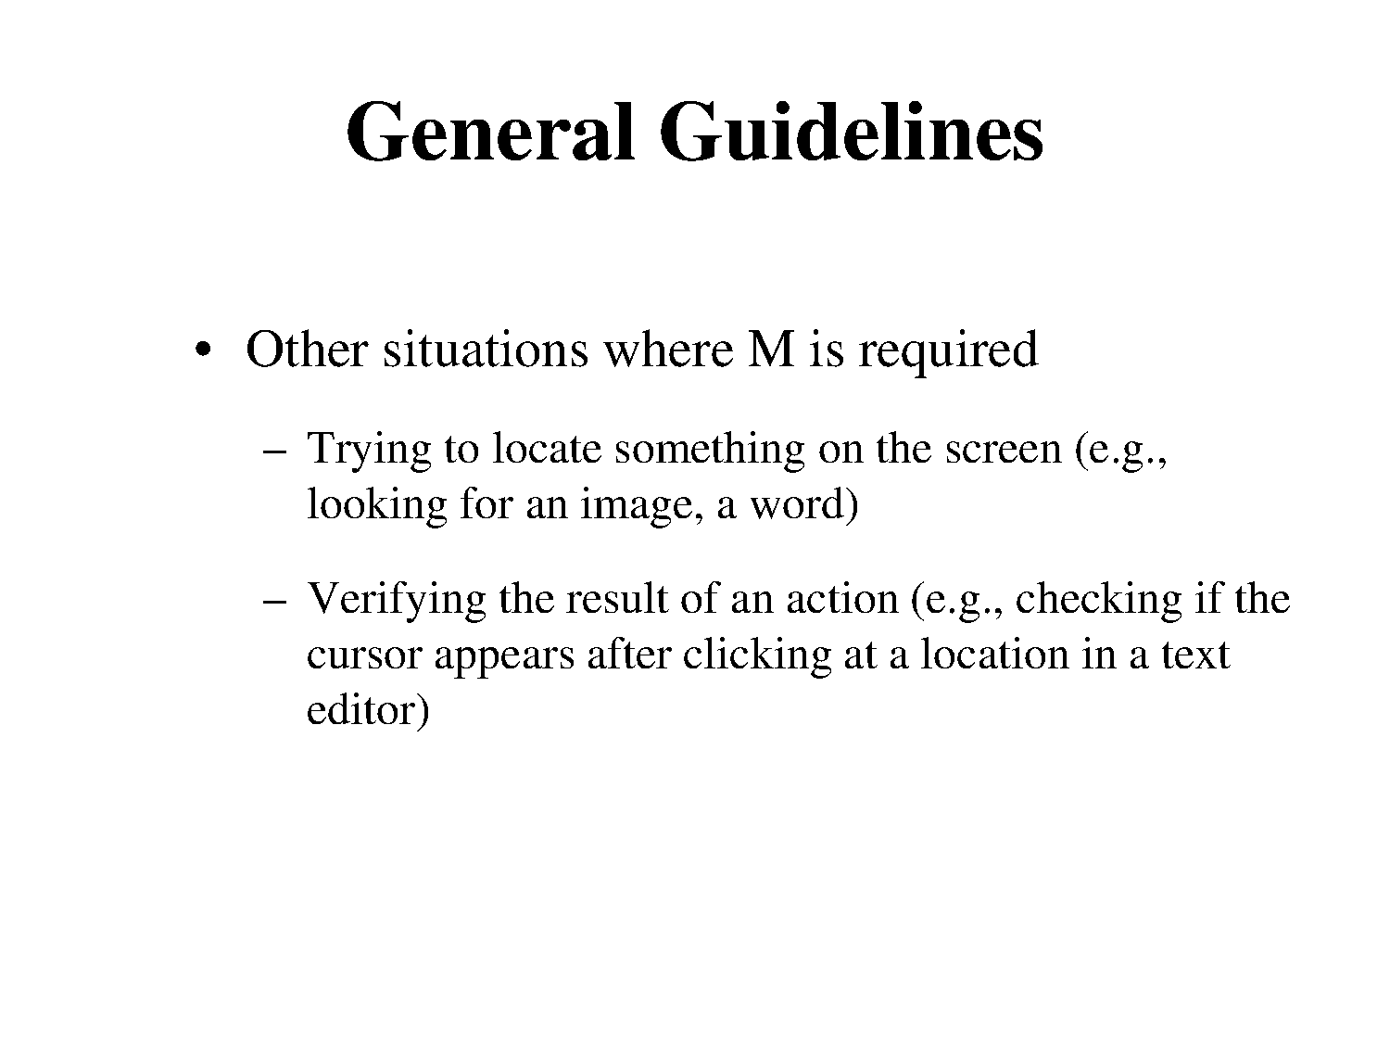

Slide 38
Heuristics for adding M’s
Basic idea: Put an M before each step requiring access of a “chunk” from long-term memory
Insert M’s before each K and P
K -> MK; P -> MP
Delete M’s in the middle of typing a word or string
MKMKMK -> MKKK
Delete M’s in the middle of composite actions (for example, point and click)
MPMK -> MPK
Adapted from Rob Miller

Slide 39
Limitations of KLM
Only applies to expert users doing routine (well-learned) tasks
Only predicts efficiency - not error rate, memorizability, learnability, etc.
Impractical for all but the simplest tasks
Ignores
Parallel processing
Goal interleaving
Mental workload (working memory limits, fatigue)
Planning and problem-solving (how to select a method?)

